Slide 1
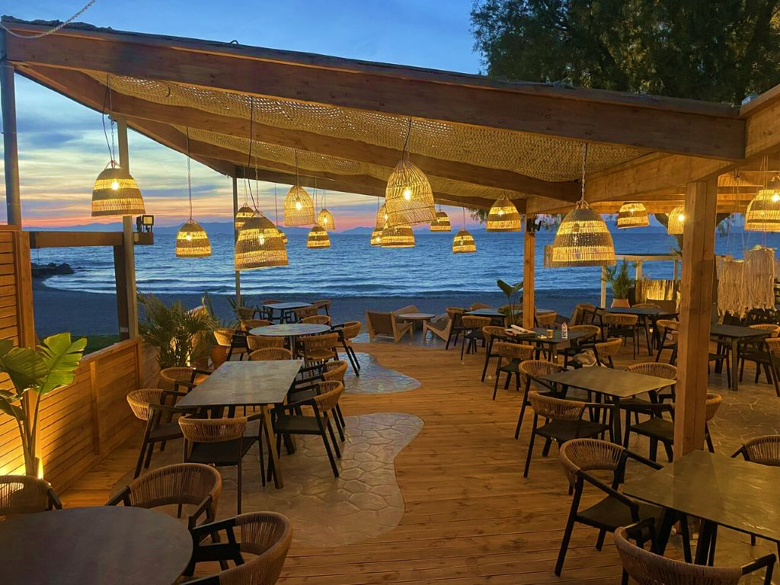
CAFE OCEAN
Gilang Wiradhyaksa
SBY - 001

Slide 2
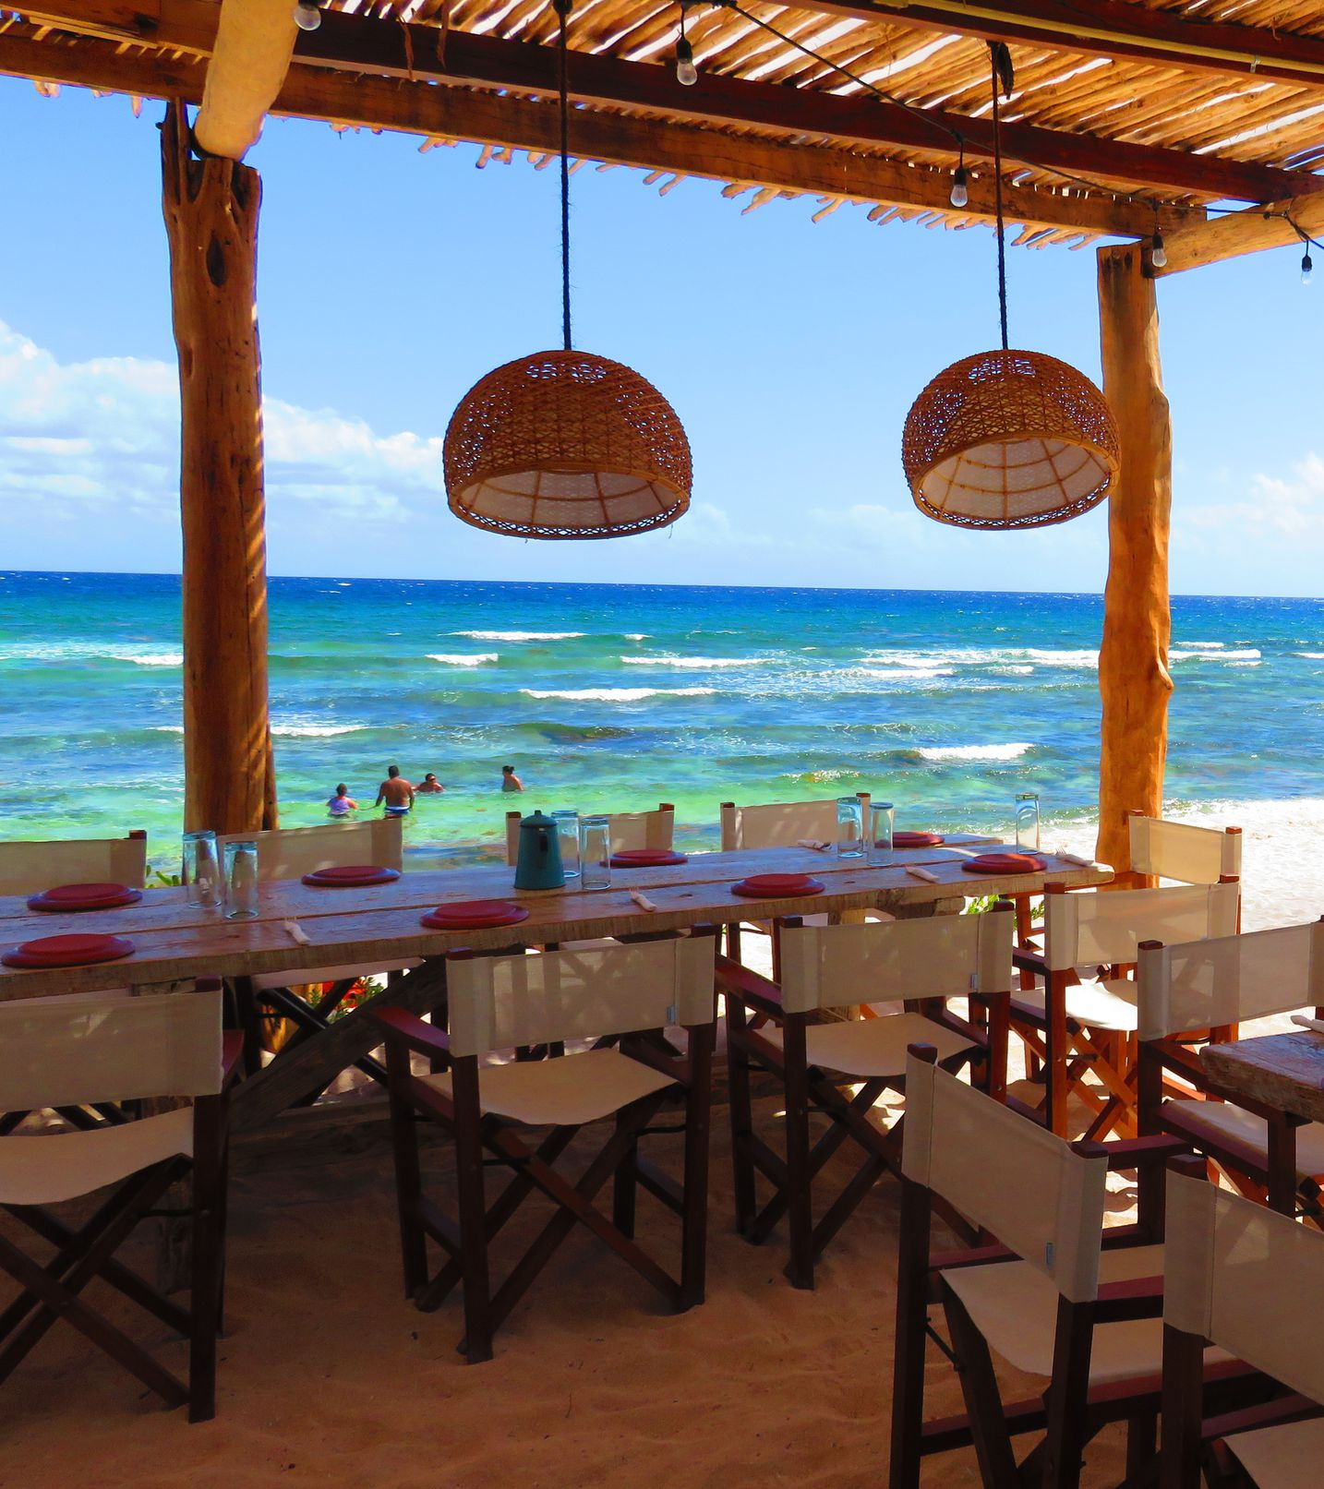
INTRODUCTION
Cafe Ocean is a beachside bar & restaurant. It wants to come up with something to improve sales and provide the best possible service to its customers.

Slide 3
TABLE OF CONTENTS
01
02
03
04
DATA OVERVIEW
EDA
Overview of the Ocean Cafe Transaction
Exploratory Data Analysis
CONCLUSION
SUGGESTION
Conclusion of the EDA
Suggestion to improve restaurant sales

Slide 4
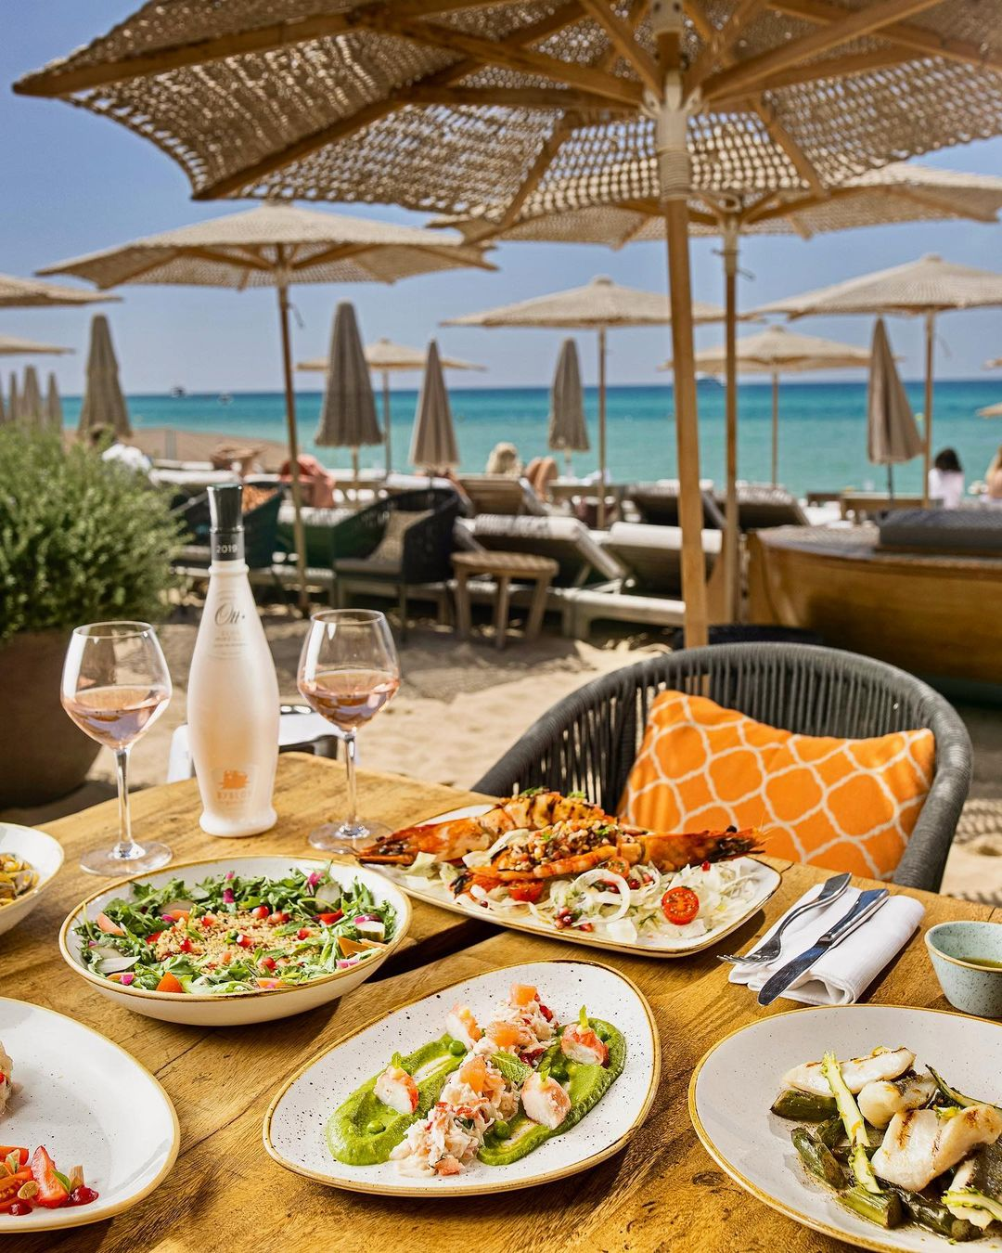
DATA OVERVIEW
This data is Ocean Cafe transaction data over the year.

Slide 5
DATA OVERVIEW
Date | Time | Bill Number | Item Description | Category | Qty | Rate | Tax | Disc | Total
2020-04-17 | 03:08:56 | G0487629 | MAGGI NDLCREAM/ CHEE/GARLIC | Food | 1 | 125.0 | 29.69 | 0.0 | 154.69
2020-12-20 | 05:36:29 | G0532106 | NIRVANA HOOKAH SINGLE | Tobacco | 1 | 300.0 | 96.00 | 0.0 | 396.00
2020-07-10 | 01:28:10 | G0502944 | JR.CHL AVALANCHE | Food | 1 | 160.0 | 38.00 | 0.0 | 198.00
2020-10-13 | 10:56:01 | G0520628 | COTTAGE CHEESE PANINI | Food | 1 | 105.0 | 24.94 | 0.0 | 129.94
2020-06-27 | 12:33:02 | G0500693 | SILVER APPLE SINGLE | Tobacco | 1 | 245.0 | 78.40 | 0.0 | 323.40
2020-09-07 | 11:08:44 | G0513140 | OCEAN SPECIAL FLOAT W VANILLA | Beverage | 1 | 50.0 | 11.88 | 0.0 | 61.88
2020-02-21 | 09:11:21 | G0478081 | VEG. CLUB WRAP | Food | 1 | 155.0 | 36.81 | 0.0 | 191.81
2020-10-11 | 06:28:31 | G0520188 | CALCUTTA MINT | Tobacco | 1 | 450.0 | 144.00 | 0.0 | 594.00
2020-07-20 | 10:26:22 | G0504661 | OCEAN SPECIAL FLOATS W CHOC | Beverage | 1 | 50.0 | 11.88 | 0.0 | 61.88
2020-08-25 | 10:15:21 | G0510746 | SAMBUCA | Tobacco | 1 | 350.0 | 112.00 | 0.0 | 462.00
2020-05-06 | 11:40:04 | G0491477 | COTTAGE CHEESE PANINI | Food | 1 | 105.0 | 24.94 | 0.0 | 129.94
2020-11-03 | 07:24:21 | N0033076 | TUBORG | Liquor | 1 | 100.0 | 31.25 | 0.0 | 131.25
2020-07-11 | 08:44:04 | G0503199 | CAPPUCCINO | Beverage | 1 | 60.0 | 14.25 | 0.0 | 74.25

Slide 6
DATA OVERVIEW
This data is updated automatically every day at 6.30 AM using Apache Airflow.
The new data also goes through a Cleaning and Validation process to ensure the data is always valid.

Slide 7
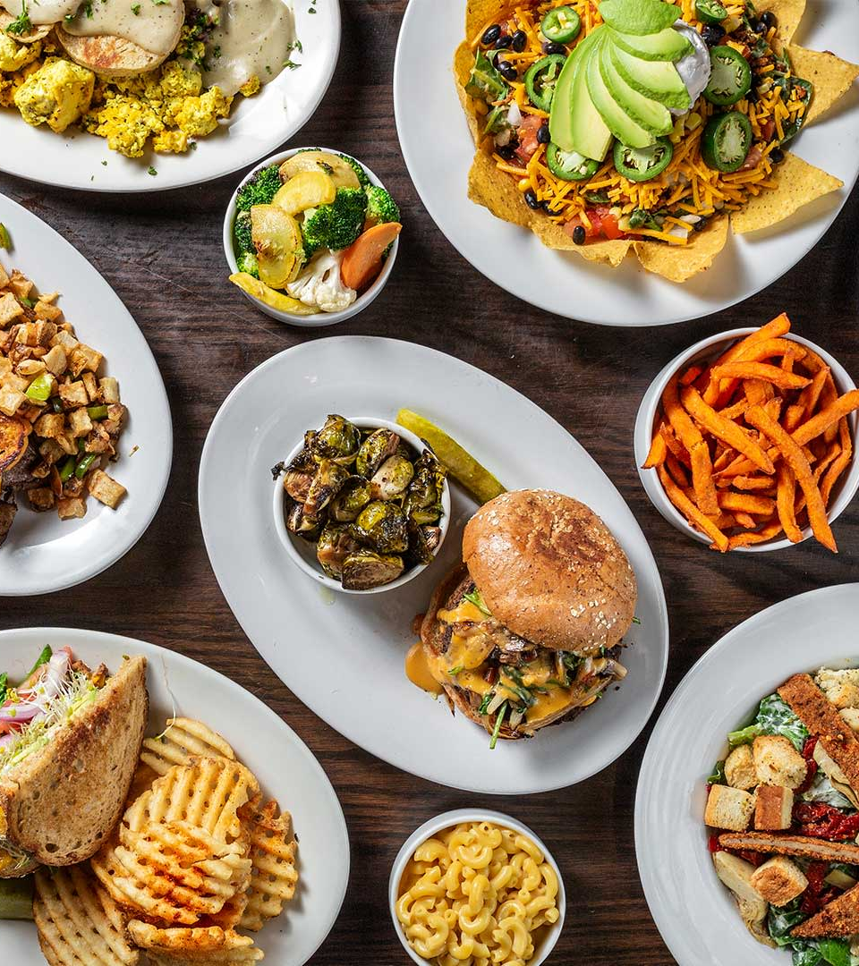
EDA
Exploratory Data Analysis
This section contains data visualization and insight based on the data.

Slide 8
SALES BY MONTH
Slowly raising since February
Reach its peak at October
Declining until end of the year

Slide 9
SALES BY CATEGORY
Tobacco
Food
Beverage
Liquor
Wines

Slide 10
CATEGORY SOLD BY QUANTITY
Wines
1.070 - 1%
Food
61.171 - 38%
Liquor
10.283 - 6%
Tobacco
37.182 - 23%
Beverage
50.577 - 32%

Slide 11
BEST SELLING FOOD

Slide 12
MOST CUSTOMER BY HOUR
Starting to rise since afternoon
Most customer at 7pm
Very few customer during early morning

Slide 13

MOST CUSTOMER BY DAY
Most of the restaurant customer come at Thursday
Tuesday is when the restaurant having least customer

Slide 14
MOST CUSTOMER BY MONTH
Most customer at September
Least customer at February
Customer is declining since September

Slide 15
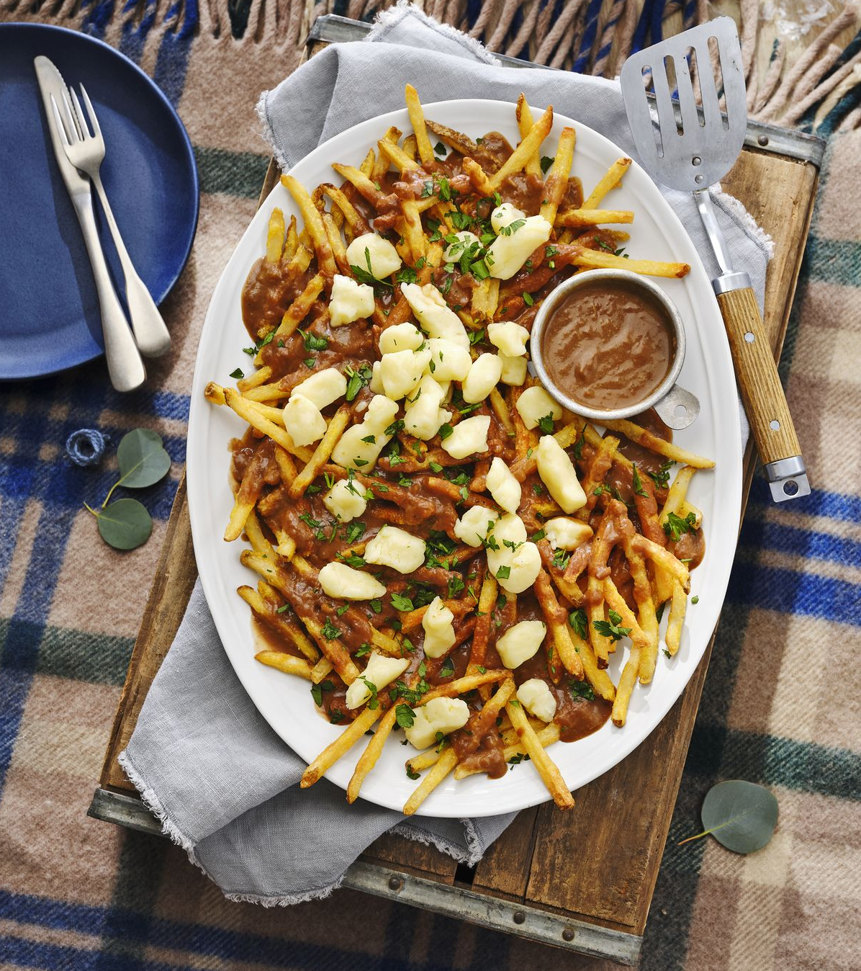
Conclusion
Based on the EDA we do, we found that the restaurant have declining revenue for the last 3 month that is caused by a decrease in the number of customers in the last 3 month.
The restaurant best-selling food is Ocean Special Shake and Poutine with Fries.
And category product with highest sales for restaurant is Tobacco.

Slide 16
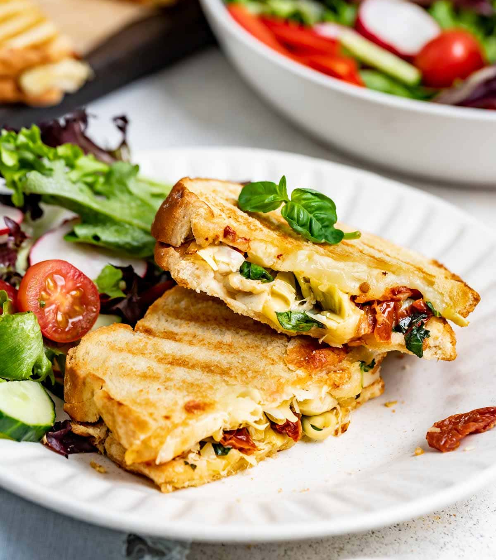
SUGGESTION
Bundling best selling food with complementary item.
Train staff to upselling and cross-selling.
Ensure staff is well-prepared to handle higher volume of customer during busy hour
Offer special discount for off-peak day.
Host special events for the slowest month.

Slide 17
THANK YOU
Do you have any questions?
gilang.wirad@gmail.com

Slide 18
Them
Us
Jupiter is a gas giant and the biggest planet in the Solar System
Venus has a beautiful name and is the second planet from the Sun

Slide 19
SWOT ANALYSIS
Strengths
Weaknesses
Opportunity
Threats
Despite being red, Mars is a cold
Saturn is composed of hydrogen
Mercury is the closest planet
Neptune is the farthest planet

Slide 20
PRODUCT OVERVIEW
Venus
Saturn
Is the second planet from the Sun in our System
It’s a gas giant, composed of hydrogen and helium
Neptune
Venus is the second planet from the Sun

Slide 21
CASE STUDY
Challenge
Results
Solution
Jupiter is the biggest planet in the Solar
It’s composed mostly of hydrogen and helium
Despite being red, Mars is actually a cold place

Slide 22


150,0000
Big numbers catch your audience’s attention

Slide 23
OUR AWARDS
2010
2016
2014
2020
Saturn
Jupiter
It’s composed mostly of hydrogen and
Jupiter is the biggest planet in the Solar
Neptune
Mars
Is the eighth and farthest planet
Is actually a cold place. It’s full of iron

Slide 24
OUR COMPETITORS
Venus
Mars
Mercury is the smallest planet in the entire
Mercury
Despite being red, Mars is a cold place.
Venus has a beautiful name and is the second

Slide 25
BUSINESS MODEL
Marketing
Assessment
Despite being red, Mars is a cold place
Jupiter is a giant and the biggest planet
Training
Technology
Venus has a
beautiful name
Mercury is the closest planet to the

Slide 26
ALTERNATIVE RESOURCES

